Slide 1



Advance Library Management
System: A Smart and Efficient Approach
UNDER THE GUIDANCE OF:-
Mr. ANUJ SHARMA
Cranes Varsity

Slide 2
Submitted By:-
GROUP: 4(16)
CL2025010601911753 | Pritanshu Kumar Mallick (T. L.)
CL2025010601874855 | Aman Pratik Pattnaik
CL2025010601936670 | Anupam Upamanyu Satapathy
CL2025010601932327 | Sourav Kumar Nayak
CL2025010601904199 | Suvam Subhadarshi Das

Slide 3

CONTENTS
INTRODUCTION
DESIGN
TESTING
MAINTENANCE
REQUIREMENTS
IMPLEMENTATION
DEPLOYMENT

Slide 4
INTRODUCTION
In today's dynamic digital landscape, libraries serve as gateways to a world of knowledge. However, managing vast collections and catering to diverse user needs can be daunting. That's where our Library Management System steps in.
Designed with the latest technological advancements, our system not only simplifies administrative tasks but also enhances the overall library experience. With features like advanced cataloging, automated circulation management, and personalized patron services, librarians can efficiently organize resources while providing tailored support to users.
But it doesn't stop there. Our system goes beyond traditional library management by integrating cutting-edge analytics and reporting tools. By leveraging data insights, libraries can make informed decisions, optimize resource allocation, and stay ahead in today’s information-driven world.

Slide 5
REQUIREMENTS
BOOK MANAGEMENT
BOOK MANAGEMENT
ADD, REMOVE, AND UPDATE BOOKS IN THE LIBRARY INVENTORY. EACH BOOK
SHOULDHAVE A UNIQUE IDENTIFIER (BARCODE OR ISBN), TITLE,AUTHOR, GENRE, PUBLICATION YEAR, AND
AVAILABILITY STATUS
SEARCH AND BROWSE
ENABLE USERS TO SEARCH AND BROWSE THE LIBRARY CATALOG BY TITLE,AUTHOR,
GENRE, AND PUBLICATION YEAR.
MEMBER MANAGEMENT
REPORTING
REGISTER NEW LIBRARY MEMBERS.MAINTAIN MEMBER RECORDS INCLUDING
NAME,ADDRESS, CONTACTINFORMATION, AND BORROWING HISTORY.BORROWING AND RETURNING BOOKS:
ALLOW MEMBERS TO BORROW BOOKS. RECORD BORROWING AND RETURNING TRANSACTIONS.CALCULATE
OVERDUE FINES FOR LATE RETURNS.
GENERATE REPORTS ON BOOK INVENTORY, MEMBER STATISTICS, BORROWINGTRENDS, AND
OVERDUE FINES

Slide 6
DESIGN
LIBRARY: MANAGES THE LIBRARY OPERATIONS SUCH AS ADDING/REMOVING BOOKS, REGISTERING MEMBERS, HANDLING TRANSACTIONS, AND GENERATING REPORTS.
CLASS DESIGN: BOOK: REPRESENTS A BOOK WITH PROPERTIES SUCH AS TITLE, AUTHOR, GENRE, PUBLICATION YEAR, AND AVAILABILITY STATUS.
MEMBERS: REPRESENTS A LIBRARY MEMBER WITH ATTRIBUTES LIKE NAME, ADDRESS, CONTACT INFORMATION, AND BORROWING HISTORY.
TRANSACTIONS: REPRESENTS BORROWING AND RETURNING TRANSACTIONS, INCLUDING THE BOOK BORROWED, THE MEMBER WHO BORROWED IT, AND THE DATE OF THE TRANSACTION.
DATABASE DESIGN: DESIGN A DATABASE SCHEMA TO STORE INFORMATION ABOUT BOOKS, MEMBERS, TRANSACTIONS, AND OTHER RELEVANT DATA. TABLES: BOOKS, MEMBERS, TRANSACTIONS, ETC.
USER INTERFACE: DESIGN A USER-FRIENDLY INTERFACE FOR LIBRARY STAFF AND MEMBERS TO INTERACT WITH THE SYSTEM. INCLUDE SCREEN FORMS FOR BOOK MANAGEMENT, MEMBER REGISTRATION, BORROWING RETURNING BOOKS, SEARCHING BROWSING THE CATALOG, AND GENERATING REPORTS.

Slide 7

IMPLEMENTATION
BACKEND:
The backend of the application handles data storage and retrieval using a relational database management system (RDBMS) like MySQL. Java Database Connectivity (JDBC) is used to connect to the MySQ database and execute SQL queries.The ConnectMySQL class contains methods to establish a connection to the MySQL database. Prepared statements (PreparedStatement) are used to execute parameterized SQL queries to retrieve user information for authentication.
FRONTEND:
The frontend of the application is built using Java Swing, a GUI toolkit for Java. Swing components such as JFrame, JPanel, JLabel, JTextField, JPasswordField, and JButton are used to create the user interface.
The graphical user interface (GUI) includes panels for login (jPanel3) and additional information (jPanel2). Various Swing components are used to create a visually appealing and interactive interface for users to enter their username and password and perform actions such as logging in or closing the application.
INTEGRATION:
The integration between the frontend and backend is achieved through Java code that connects to the MySQL database to authenticate users. When the user clicks the "LOGIN" button (jButton1), an action event is triggered, and the corresponding action listener executes Java code to query the database and authenticate the user. If the authentication is successful, a new window (Home) is opened to proceed with the application. Otherwise, an error message is displayed using JOptionPane.

Slide 8
DEPLOYMENT
DEPLOY THE LIBRARY MANAGEMENT SYSTEM TO A PRODUCTION ENVIRONMENT.
ENSURE THAT THE SYSTEM MEETS PERFORMANCE, SECURITY, AND SCALABILITY REQUIREMENTS.
PROVIDE TRAINING TO LIBRARY STAFF ON USING THE SYSTEM EFFECTIVELY

Slide 9
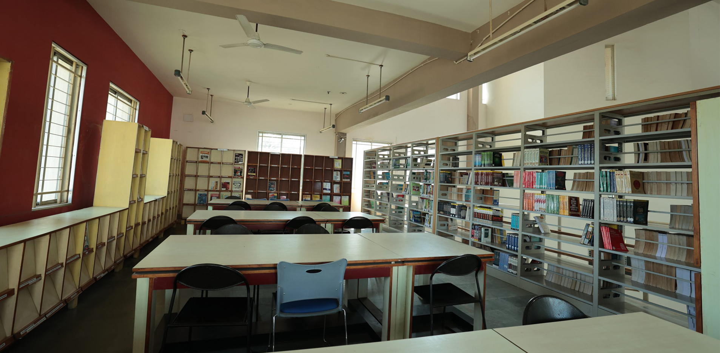
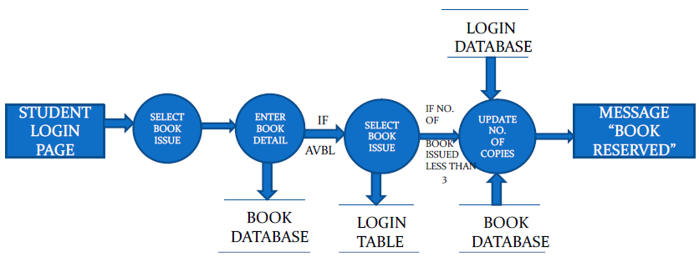

Slide 10
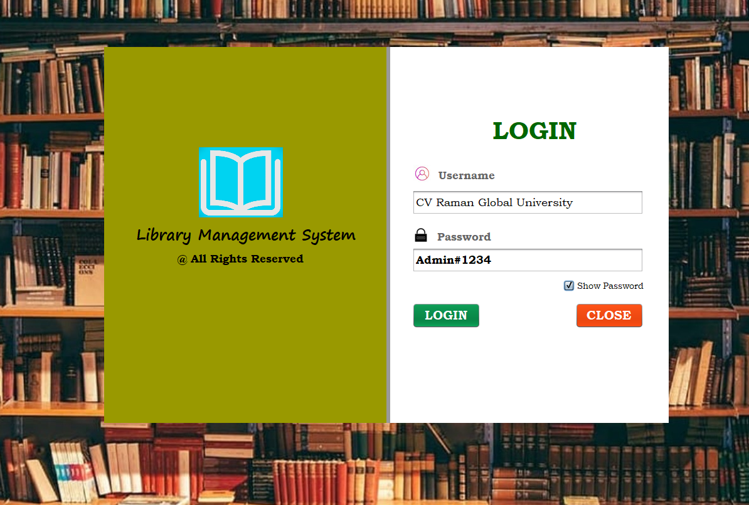

Slide 11
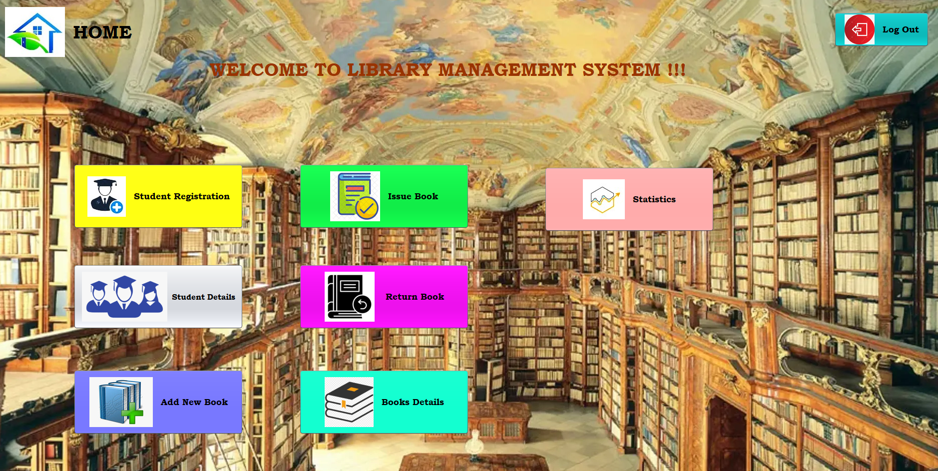

Slide 12
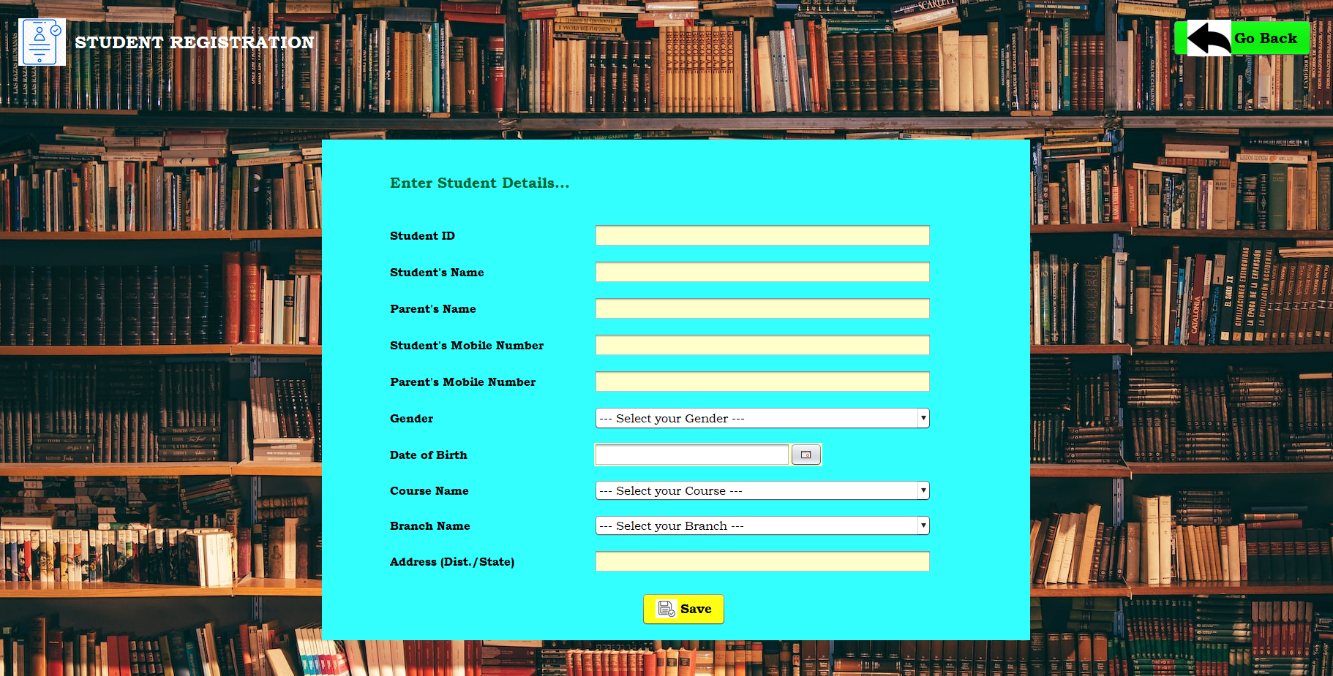

Slide 13
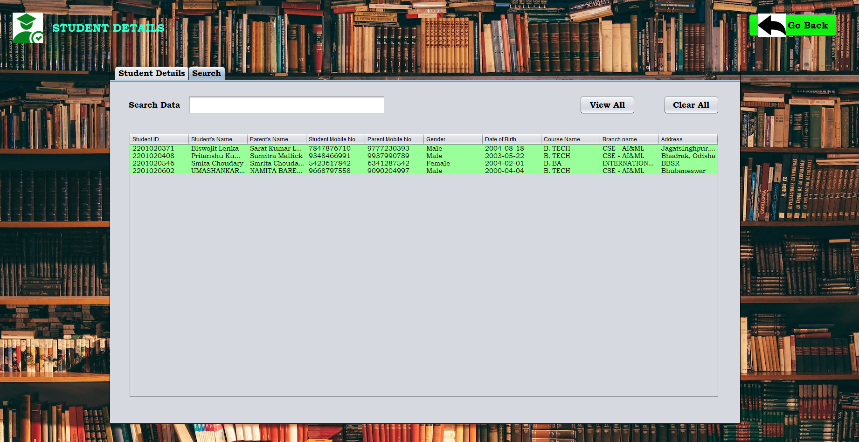

Slide 14
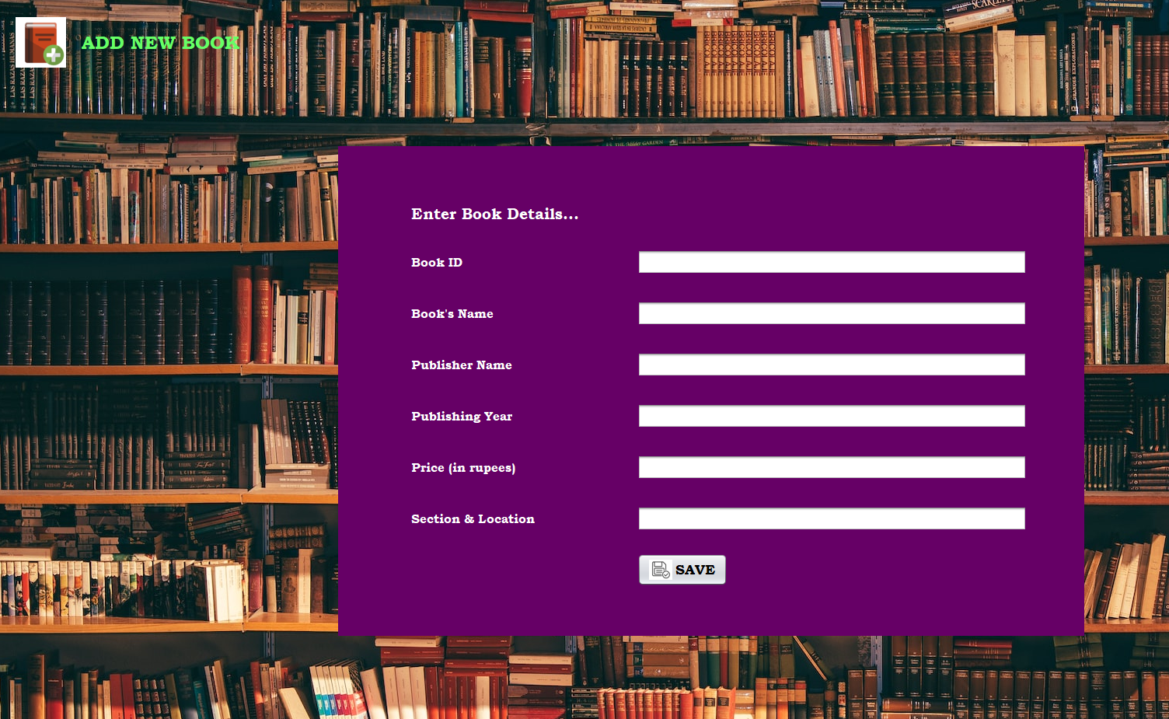

Slide 15
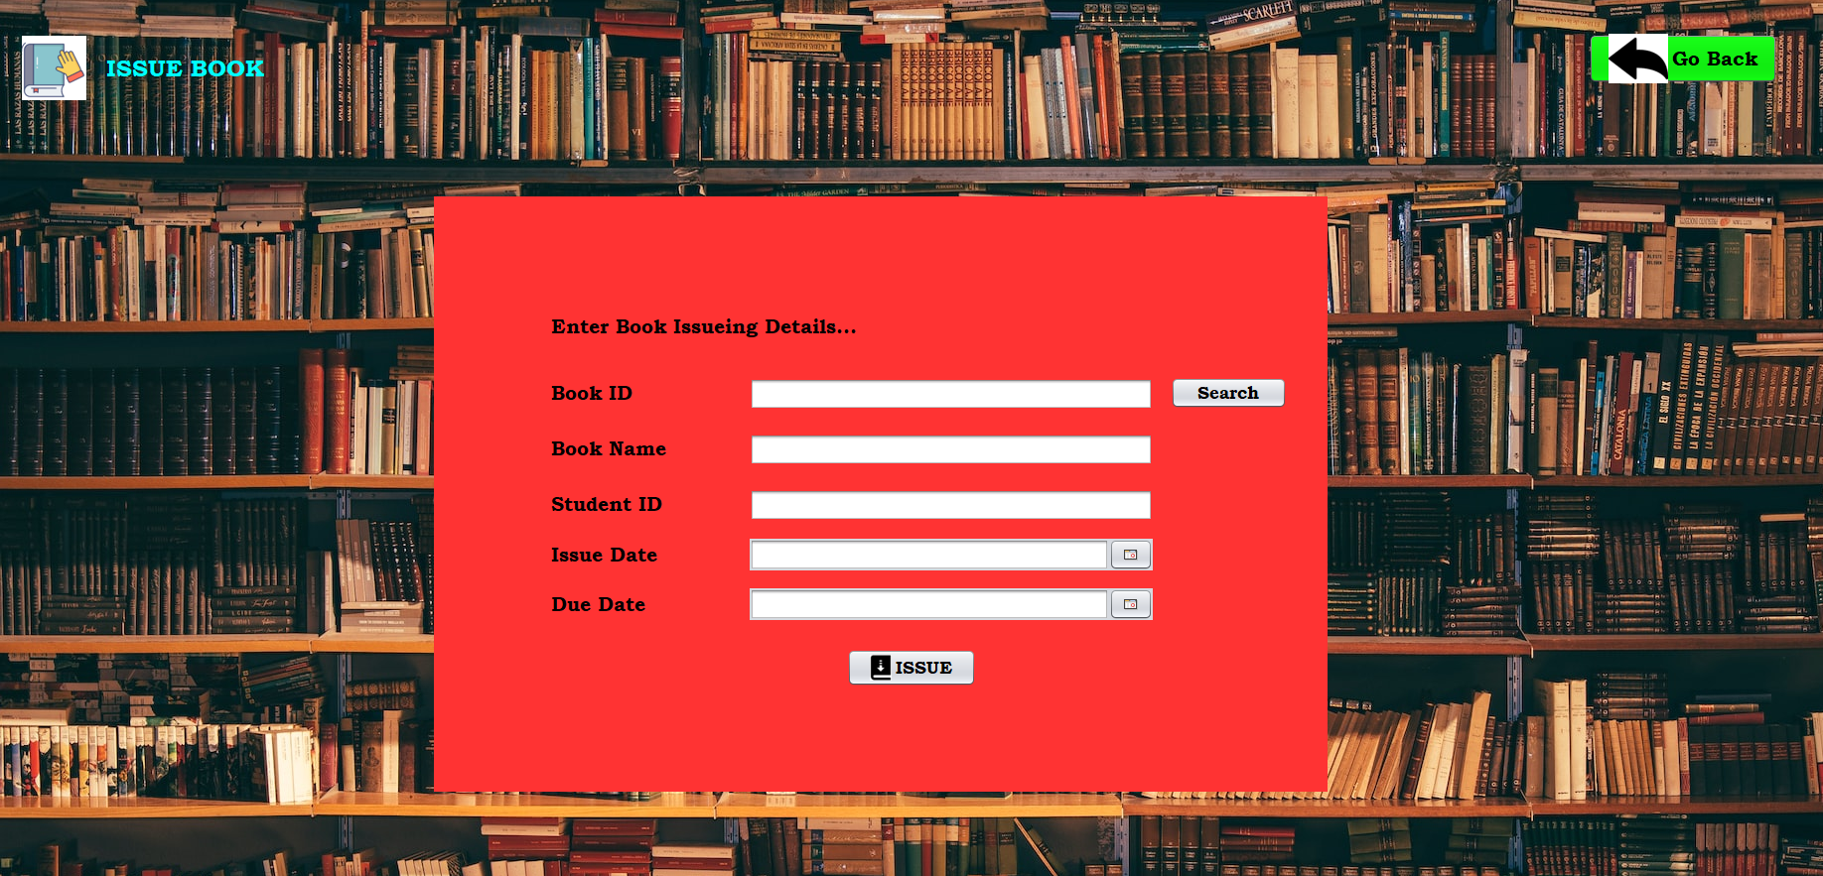

Slide 16
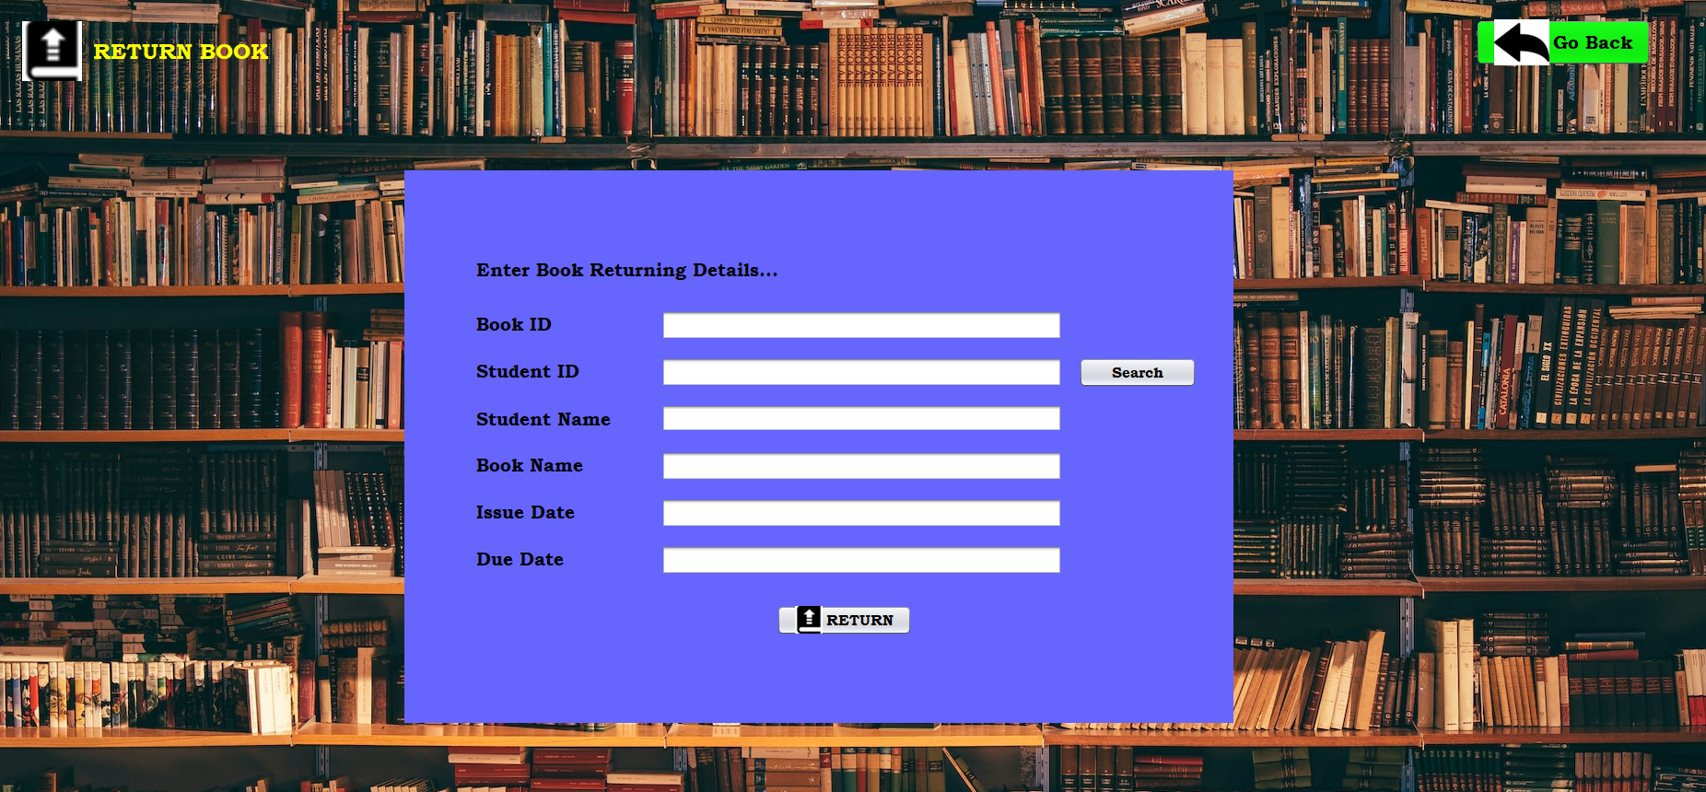

Slide 17
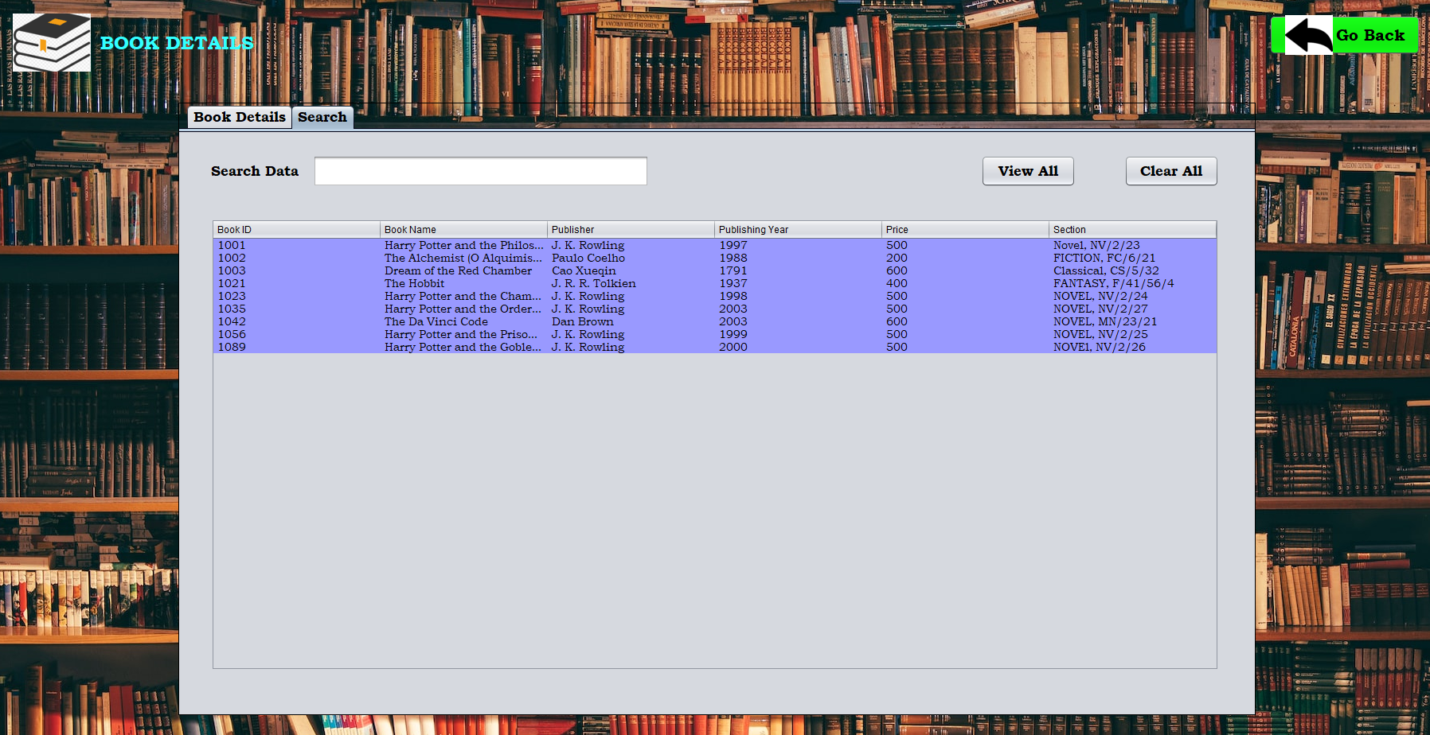

Slide 18
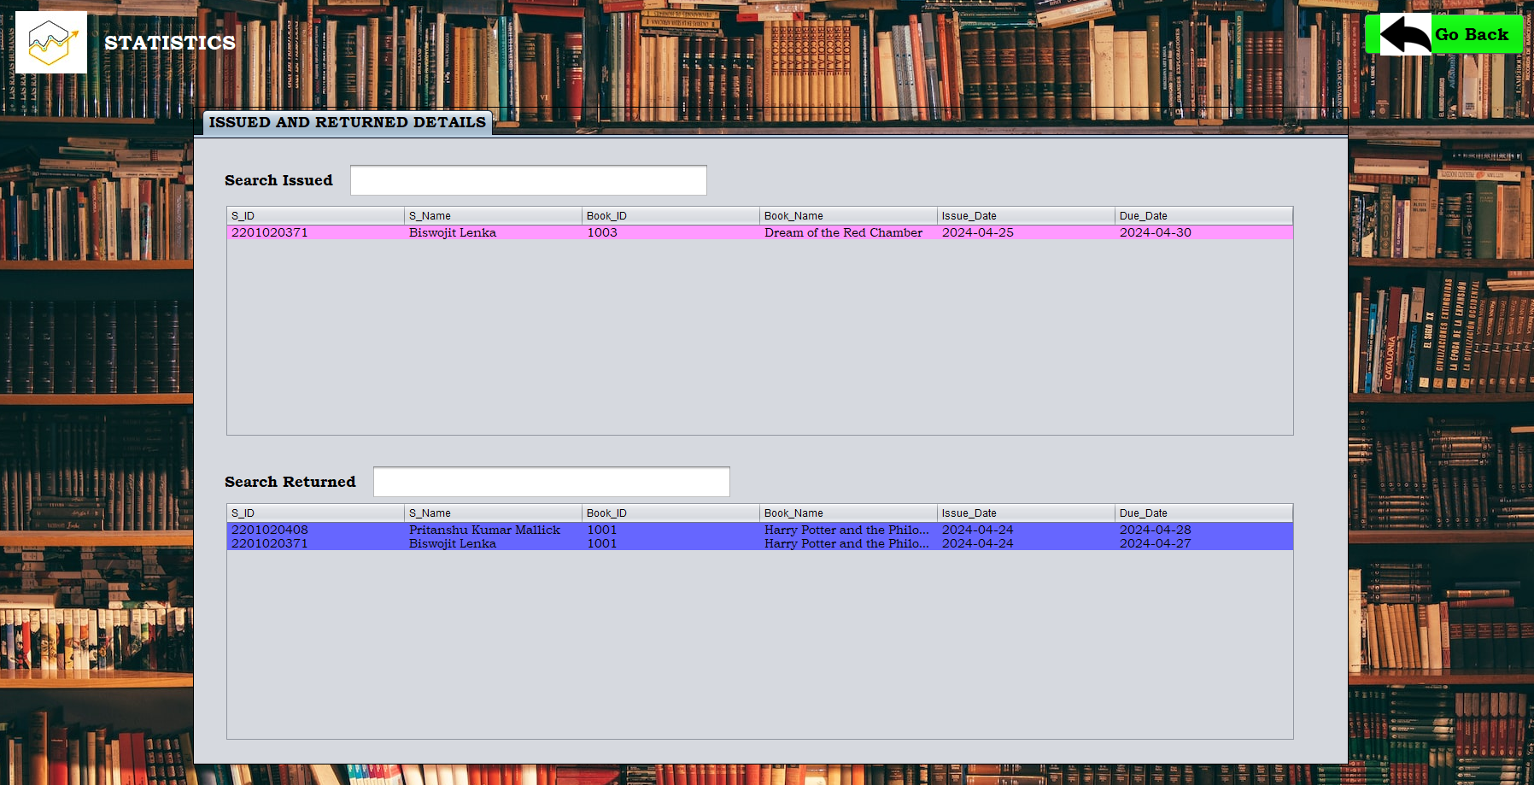

Slide 19
Maintenance
Regularly update the system to add new features, fix bugs, and improve performance.
Provide ongoing support to address any issues or concerns raised by library staff and members.
Stay informed about emerging technologies and trends in library management to keep the system up-to-date.
This case study outlines the basic steps involved in designing, implementing, and deploying a library management system in Java. Actual implementation details may vary depending on specific requirements, technology choices, and constraints.

Slide 20
Future Enhancements
A Library Management System (LMS) can evolve with new technologies and user needs.
Below are some future scope enhancements that can improve efficiency, security, and user experience.
Key Advancements:
1️⃣ Cloud-Based System – Access library anywhere, auto backups. 2️⃣ AI-Powered Recommendations – Personalized book suggestions. 3️⃣ RFID & IoT Automation – Smart book tracking, self-checkout. 4️⃣ Mobile App Integration – Online book reservations, QR scanning. 5️⃣ Blockchain Security – Secure transactions & digital book ownership. 6️⃣ Voice-Activated Search – Google Assistant/Alexa integration. 7️⃣ Advanced User Analytics – Reading trends & book demand insights. 8️⃣ Multi-Language Support – Library for diverse users.

Slide 21

conclusion
In conclusion, the implementation of the library management system demonstrates the effective utilization of software tools and database management techniques to streamline library operations. Through this system, tasks such as book management, member registration, transaction handling, and report generation are efficiently automated, leading to improved library efficiency and user experience.
Thank you

